Slide 1

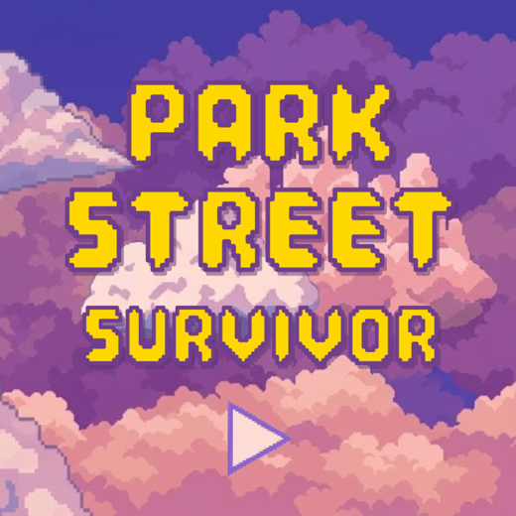
Park Street Survivor
[ Game screenshot ]
Sprint through the fragmented memories of a Bristol CS graduate
A 5-day surrealist journey on Park Street where every gift from the past shapes your ultimate choice
Charlotte Yu · Lucca Zhou · Ray Wang · Layla Pei
SEDP 2026
Group 7
JavaScript
p5.js

Slide 2
01
The Novel Idea
What makes Park Street Survivor different?

Slide 3
02
Visual Materials
AI-generated pixel art, refined by the team

Slide 4
03
Technical Challenges
State management & the narrative engine

Slide 5
04
Process & Teamwork
How we built it together

Slide 6


Process & Teamwork
How we built it together
Roles
Charlotte Yu
Product Owner
Core Mechanism
Co-Script

Slide 7

Process & Teamwork
How we built it together
Roles
Ray Wang
Level Design
Balancing
Co-Script

Slide 8

Process & Teamwork
How we built it together
Roles
Layla Pei
UI/UX
Audio
Co-Script

Slide 9

Process & Teamwork
How we built it together
Roles
Lucca Zhou
Aesthetic Design
Assets
Co-Script

Slide 10
Process & Teamwork
How we built it together
Strengths
Challenges
✦ Logic-first, art-later workflow
✦ Fortnightly sprints, deadline-synced
✦ Custom Testing Panel for rapid QA
✦ Jira-tracked PR workflow
✦ 5th member left — team of 4 absorbed all work
✦ Tutorial overhaul after Week 8 playtesting
✦ Delayed feature-freeze for UX fixes

Slide 11
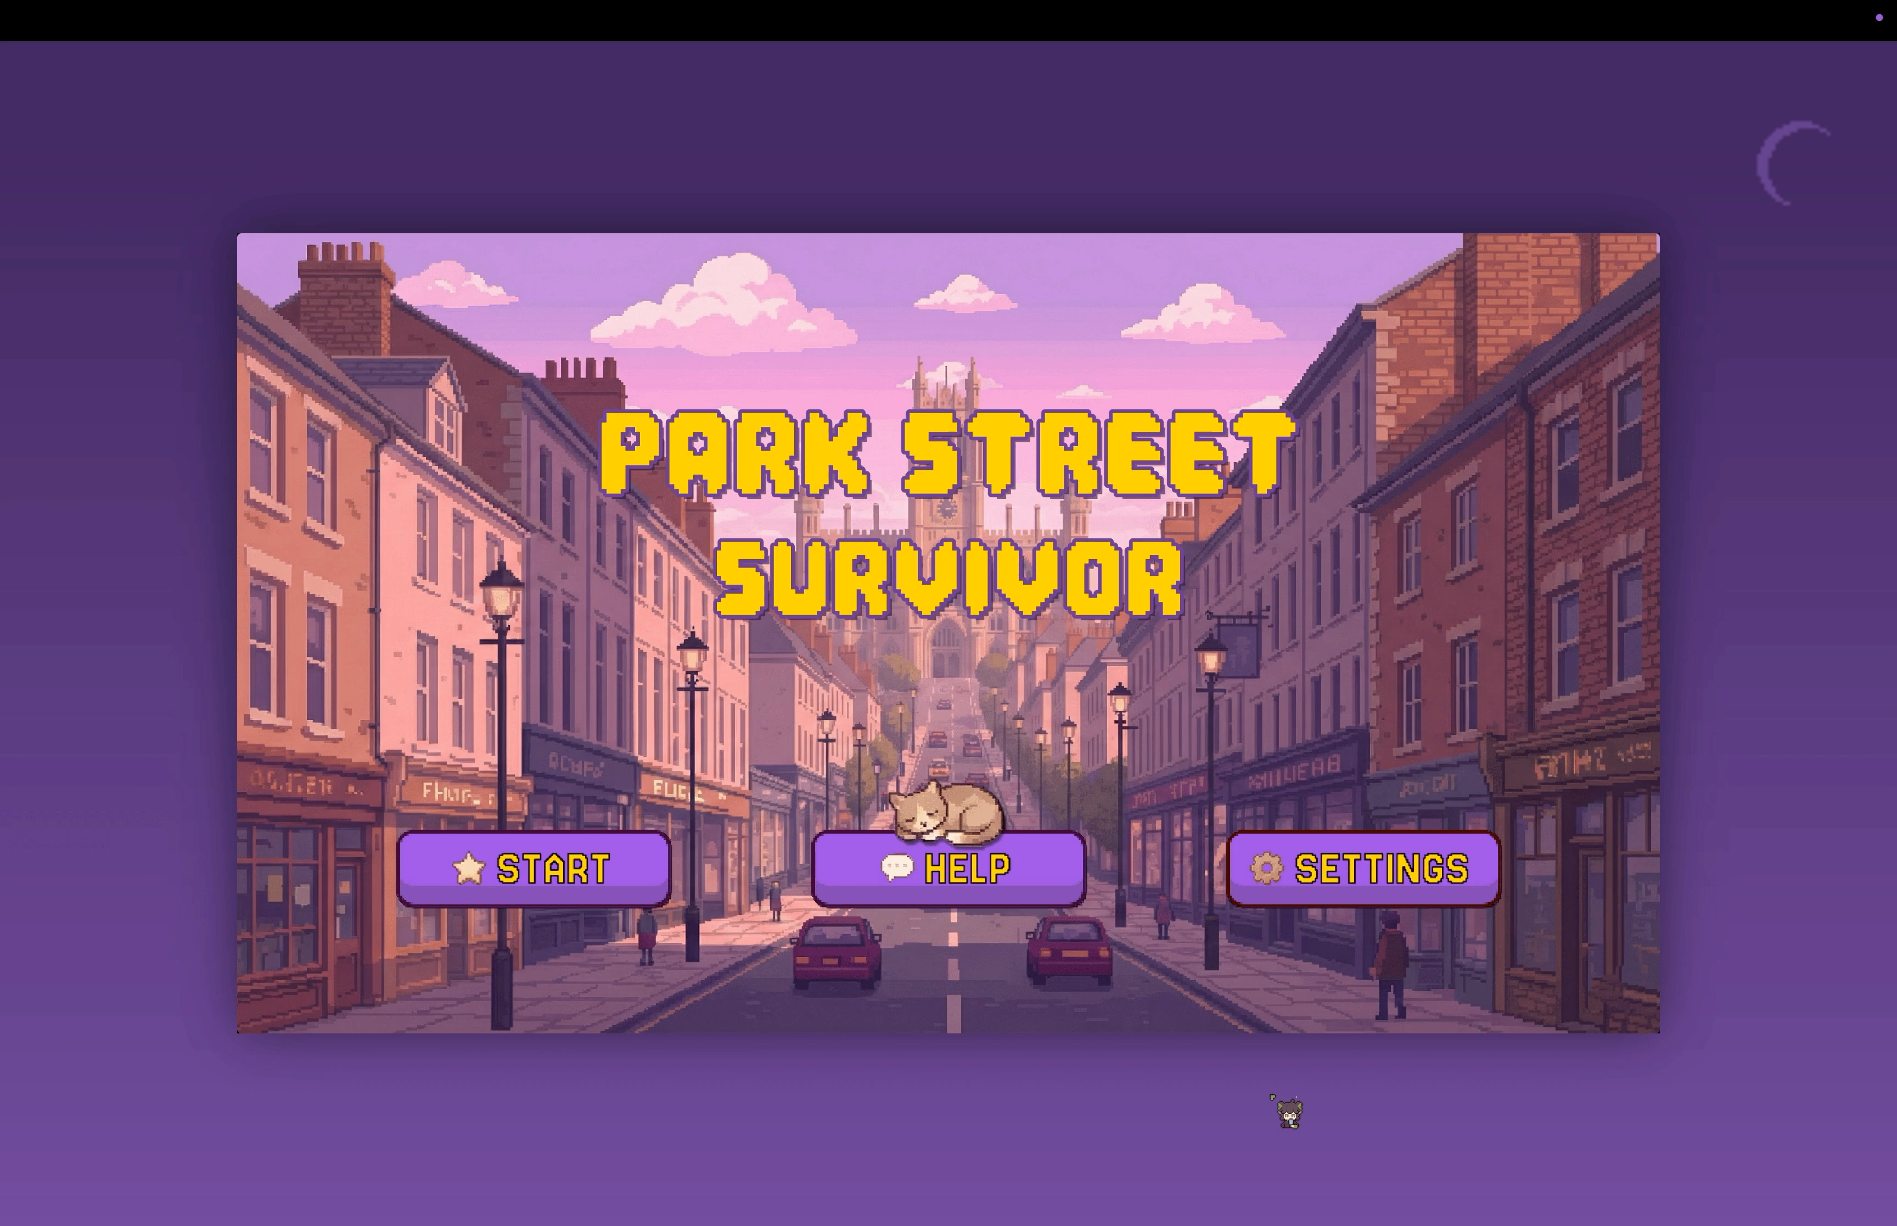
Process & Teamwork
How we built it together
Custom Testing Panel

Slide 12
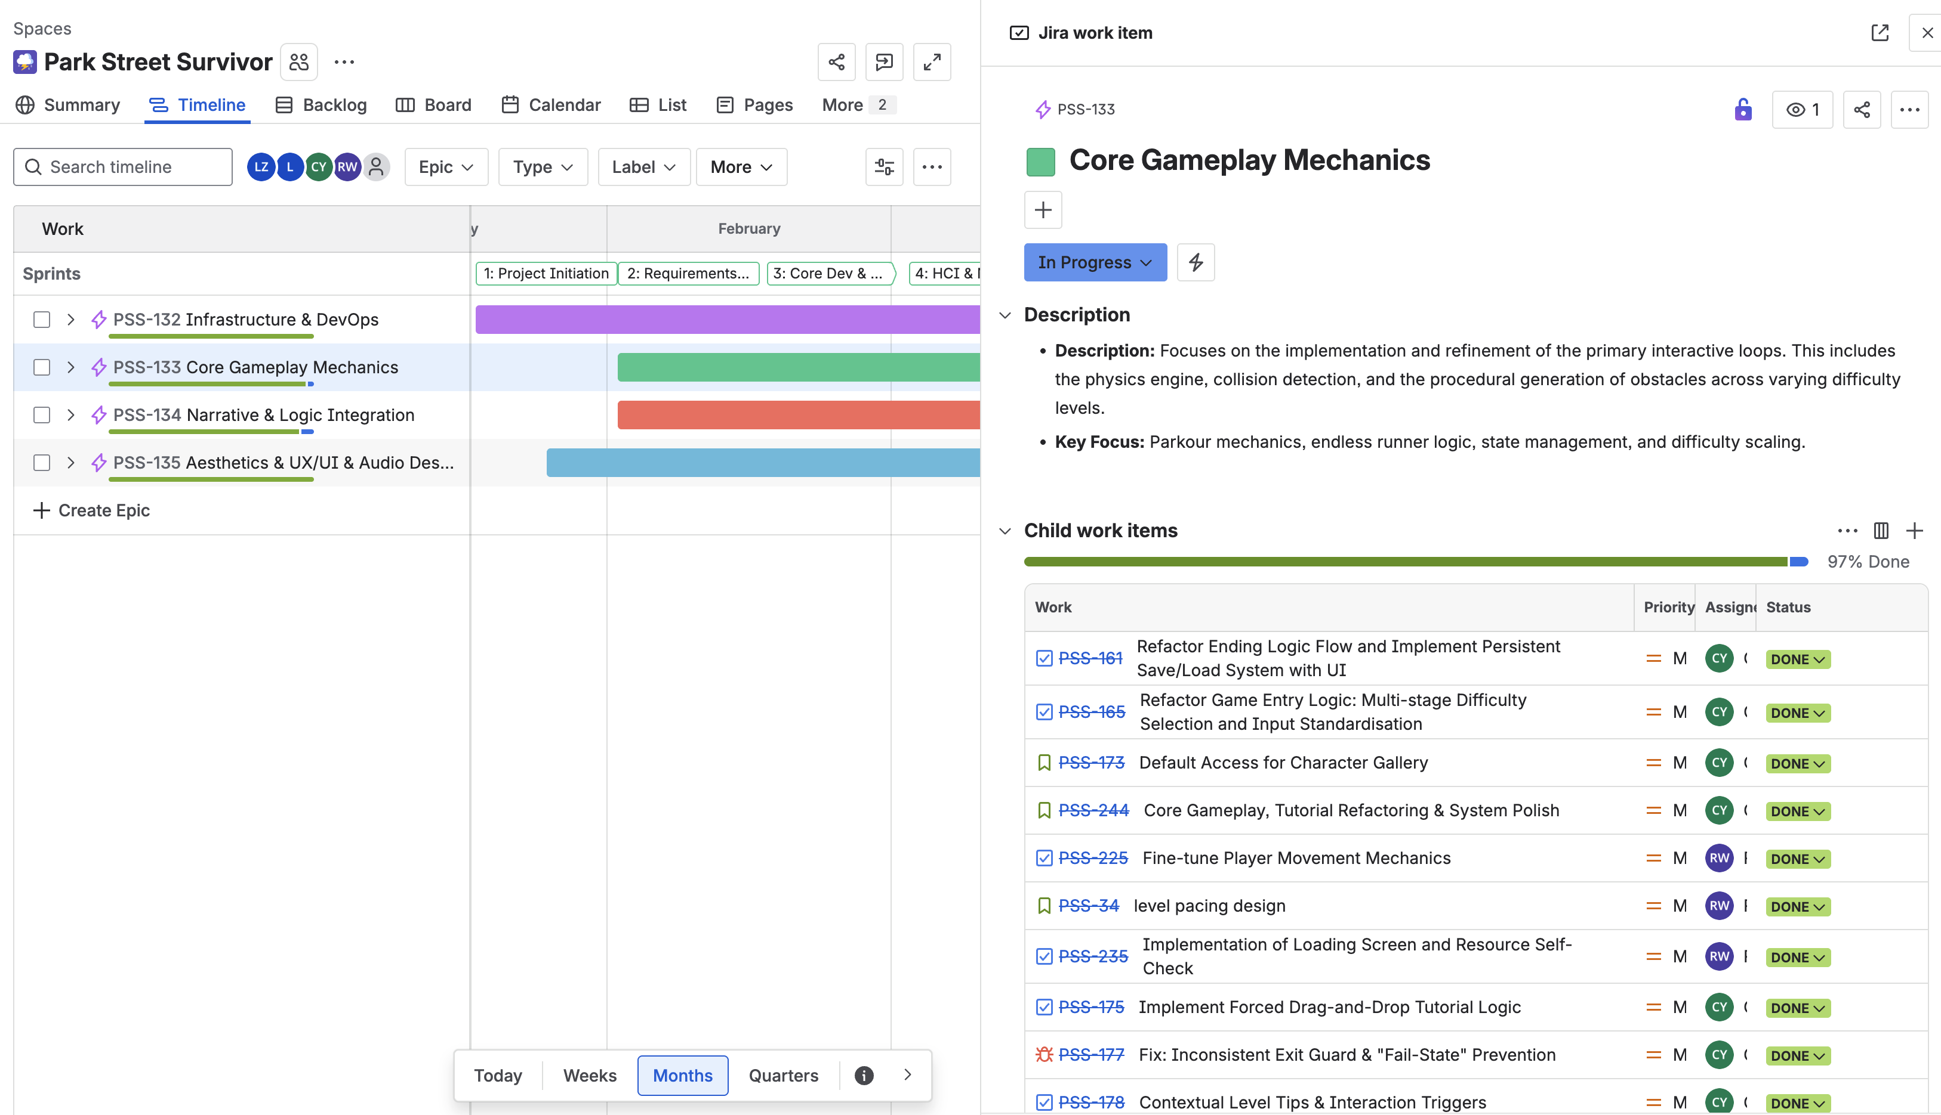
Process & Teamwork
How we built it together
Jira Kanban — Sprint Planning

Slide 13
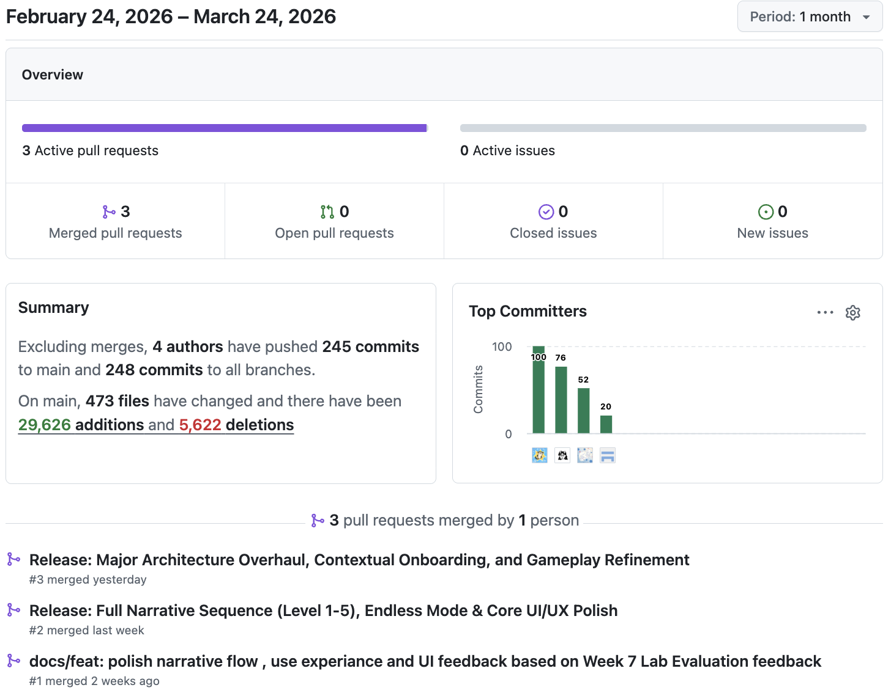
Process & Teamwork
How we built it together
GitHub Contributions

Slide 14
05
Future Work
What comes next for Park Street Survivor

Slide 15
Future Work
What comes next
Sequel Vision
✦ Expand to other Bristol landmarks (Harbourside, Clifton Bridge)
✦ Multiplayer co-op survival mode
✦ Procedurally generated narrative events
✦ Dynamic weather & seasonal Park Street variants
Thank You!
2026-Group-7 Park Street Survivor

